Slide 1
Chapter 4
Supply Chain Drivers
Supply Chain Management
(3rd Edition)
3-<number>

Slide 2
Drivers of Supply Chain Performance
Facilities
  places where inventory is stored, assembled, or fabricated
  production sites and storage sites (location, capacity and flexibility)
Inventory
  raw materials, Work In Progress, finished goods within a supply chain
  inventory policies (stocking large amount or reducing inventory)
Transportation
  moving inventory from point to point in a supply chain
  combinations of transportation modes and routes
Information
  data and analysis regarding inventory, transportation, facilities and customers throughout the supply chain
  potentially the biggest driver of supply chain performance as it affects each of the other drivers
Sourcing
  functions a firm performs and functions that are outsourced
Pricing
  Price associated with goods and services provided by a firm to the supply chain
3-<number>

Slide 3
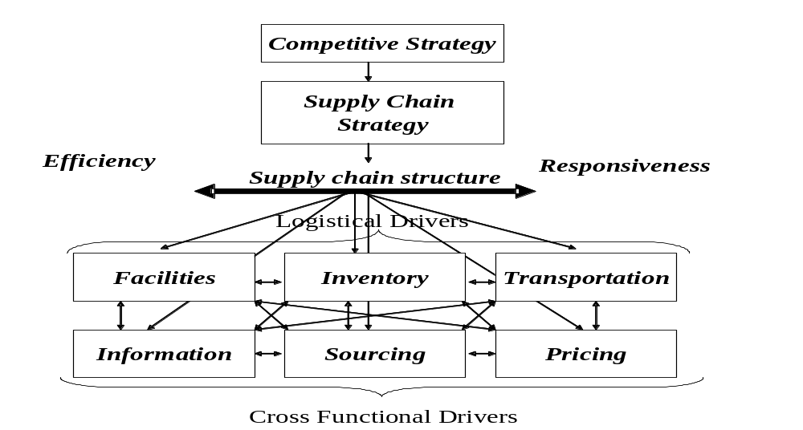
A Framework for
Structuring Drivers
The combined impact of these six drivers then determines the responsiveness and efficiency of the entire supply chain.
The supply chain must use the supply chain drivers to reach the performance level the supply chain strategy dictates.
3-<number>

Slide 4
For eg: WalMart stores
Competitive Strategy: Reliable, Wide variety, Low Cost retailer
Supply Chain Strategy: Emphasize efficiency with adequate level of responsiveness
Inventory driver: efficiency by keeping relatively low level of inventory, cross –docking (inventory is not stocked in a warehouse but rather is shipped to stores from the manufacturer)
Transportation driver: Runs its own fleet to keep responsiveness high, which in turn reduces inventories
Facilities driver: Uses central DCs to keep the no of facilities low and efficiency high
Information driver: Invested high in IT to improve communication and high responsiveness
3-<number>

Slide 5
Facilities
Manufacturing and warehousing
When the product is manufactured/stored in few locations- Efficiency
When the product is manufactured/stored in more locations- Responsiveness
Components of facilities decision
1. Location (centralize-efficient vs decentralize-responsive)
2. Capacity (flexibility versus efficiency)
3. Operations Methodology (Product focus facility vs Functional focus facility)
Product focus- many functions to produce a single product
Functional focus- few functions on many types of product
4. Warehousing Methodology-
Stock Keeping Unit (SKU)- all of one type together
Job Lot Storage- different types of products needed to perform a particular job stored together
Cross docking- goods are not stored in warehouses, instead suppliers deliver goods to a facility
3-<number>

Slide 6
Inventory
Inventory exists because of a mismatch between supply and demand
Source of cost and influence on responsiveness
Impact on material flow time (time elapsed between when material enters the supply chain to when it exits the supply chain) and throughput (rate at which sales to end consumers occur,
I (Inventory) = R (throughput) * T (flow time)
Components of Inventory Decisions
Cycle inventory
  Average amount of inventory used to satisfy demand between shipments
  Cost of holding larger lots of inventory vs cost of ordering product frequently
Safety inventory
  inventory held in case demand exceeds expectations, to counter uncertainty
  costs of carrying too much inventory versus cost of losing sales
3-<number>

Slide 7
Seasonal inventory
  inventory built up to counter predictable variability in demand
  cost of carrying additional inventory versus cost of flexible production
Overall trade-off: Responsiveness versus efficiency
  more inventory: greater responsiveness but greater cost
  less inventory: lower cost but lower responsiveness
3-<number>

Slide 8
Transportation
Moves the product between stages in the supply chain
Faster transportation -greater responsiveness but lower efficiency & vice versa
Components of Transportation Decisions
1. Mode of transportation:
  air, truck, rail, ship, pipeline, electronic transportation
  vary in cost, speed, size of shipment, flexibility
2. Route and network selection
  route: path along which a product is shipped
  network: collection of locations and routes
3. In-house or outsource
Overall trade-off: Responsiveness (speed) versus efficiency (cost)
3-<number>

Slide 9
Information
Serves as a connection between the various stages in the supply chain – allows coordination between stages
Crucial to daily operation of each stage in a supply chain – e.g., production scheduling, inventory levels
Allows supply chain to become more efficient and more responsive at the same time (reduces the need for a trade-off)
Component of Information Decision
Push (MRP) versus pull (demand information transmitted quickly throughout the supply chain)
Coordination and Information Sharing
Forecasting and Aggregate Planning
Enabling technologies
  EDI, Internet, ERP systems, Supply Chain Management software
Overall trade-off: Responsiveness versus efficiency
3-<number>

Slide 10
Sourcing
The tasks that will be outsourced and those that will be performed within the firm.
Whether to source from single supplier or portfolio of suppliers
Identify the set of criterion that will be used to select suppliers and measure their performance, contract negotiation
Sourcing decisions are crucial because they affect the level of efficiency and responsiveness in a supply chain
Components of Sourcing Decisions
In-house vs. outsource decisions- improving efficiency and responsiveness
Supplier evaluation and selection
Procurement process
3-<number>

Slide 11
Pricing
Pricing determines the amount to charge customers in a supply chain
Pricing strategies can be used to match demand and supply
Firms can utilize optimal pricing strategies to improve efficiency and responsiveness
Low price and low product availability; vary prices by response times
Components of Pricing Decisions
Pricing and economies of scale
Everyday low pricing versus high-low pricing
Fixed price versus menu pricing
3-<number>

